Slide 1
Language

Slide 2
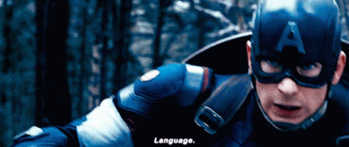
When chatting with a customer you must watch your….

Slide 3
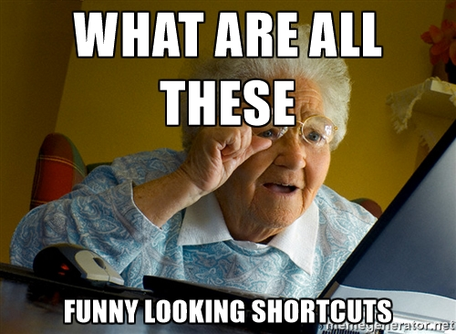
Remember to avoid Jargon and abbreviations when it isn’t needed.

Slide 4
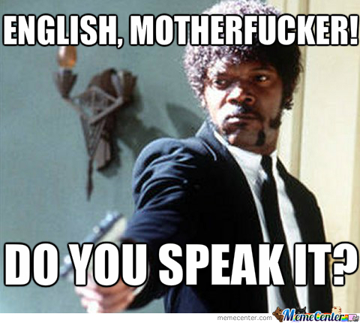
In order to avoid this...

Slide 5
Use the correct question structure, make sure to put a question mark.
Avoid using words that you do not know
Let’s do this...
In English direct questions are initiated with a verb.
Can you? Will you? Do you?
If you are not sure of the meaning of a word, double check before you hit send.
Always use capital letters
KISS (Keep It Silly Simple)
In English names, months, days of the week and the pronoun I are always capitalized
Do not complicate or over elaborate the phrases you use.
Never use internal words with the customer
Use Courtesy Phrases
They do not know what KDB or ITT is, so avoid using this words with them.
Please/ Could you/ May you And others…….

Slide 6
If you feel like you needed, ask for help.
Do an extra English course or study on your own.
There is no shame on learning and studying, but it is shameful to pretend that you know something and then not being able to demonstrate it. Here is the link to a course I recommend: Https://avi.cuaed.unam.mx/practica-ingles.html
Language coaching

